Slide 1
CROSS VALIDATION
BY : ANGELA ERDIAW- KWASIE
(Ms. Statistics)

Slide 2
CONTENTS
RESAMPLING METHOD
INTRODUCTION TO CROSS VALIDATION AND TYPES
ANALYSIS RESULTS INTERPRETATION- Using An Example
OTHER APPLICATIONS
LIMITATIONS
REFERENCES

Slide 3
RESAMPLING METHOD
Repeatedly drawing samples from a training data and refitting a model of interest to each new sample in order to obtain additional information about the fitted model. For example, estimate the variability in a linear regression fit.
SOME METHODS
Cross Validation
Bootstrapping (measure of accuracy of a parameter estimate of a statistical method)

Slide 4
CROSS VALIDATION
Estimate the test error associated with a statistical method in order to evaluate its performance- Model Assessment.
Select the appropriate level of flexibility of a model- Model Selection.
TEST ERROR (average error that results from using a statistical learning method to predict the response on a new observation)
TYPES
Validation Set Approach
Leave-One- Out Cross Validation
K- Fold Cross Validation

Slide 5
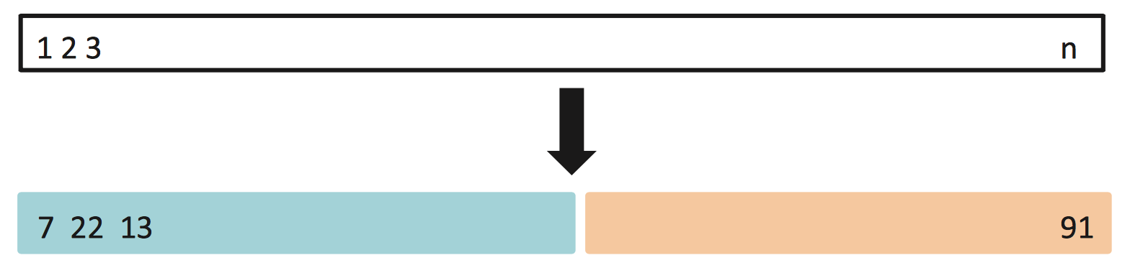
TYPES (explanation)
(50%- 70%) (50%-30%)
Advantages
Simple Strategy
Disadvantages
Biasedness depending on precisely which observations are included in the training set and which are in the validation set.
Overestimate the test error rate due to fewer observations used in fitting the model.
Validation Set Approach

Slide 6
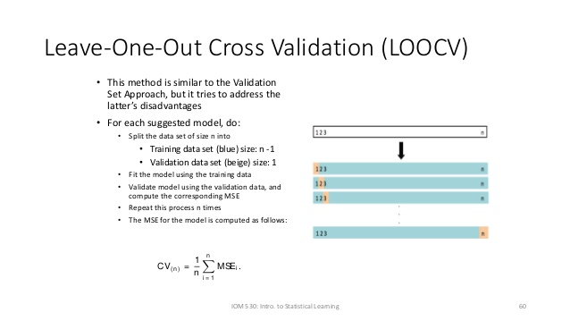
Advantages
Gives unbiased estimate of the MSE.
Disadvantages
Poor estimate because it is highly variable since it is based on single observation.
Time consuming and computational problems when n is large

Slide 7
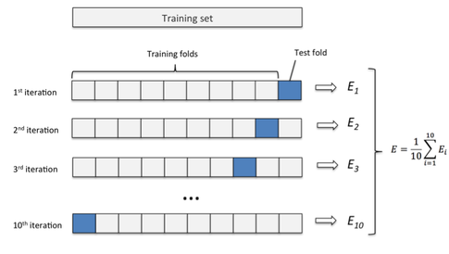
K- Fold Cross Validation
Advantages
Low variability
More accurate estimates than that of LOOCV .
Disadvantages
Computationally expensive

Slide 8
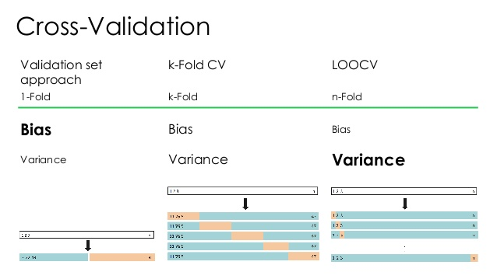

Slide 9
Working Example
DATA (Automobile Dataset)
Predicting miles per gallon (mpg) using horsepower
Final model: mpg= 23.45-120.14 horsepower+ 44.09 (horsepower)^2

Slide 10
SOFTWARE DEMONSTRATION IN R
VALIDATION SET
library(ISLR)
fix(Auto)
set.seed(1)
train=sample(392 ,196)
lm.fit =lm(mpg~poly(horsepower,2) ,data=Auto ,subset =train )
attach (Auto)
mean((mpg -predict (lm.fit ,Auto))[-train ]^2)
#[1] 19.82259

Slide 11
LEAVE- ONE- OUT APPROACH
library(boot)
LOOCV=NULL
for(i in 1:5){
model=glm(mpg~poly(horsepower, i), data= Auto)
LOOCV[i]=cv.glm(Auto, model)$delta [1]
}
LOOCV
#[1] 24.23151 19.24821 19.33498 19.42443 19.03321

Slide 12
K-Fold Cross Validation
set.seed(17)
Kcverror=NULL
for(i in 1:5){
glm.fit=glm(mpg~poly(horsepower ,i),data=Auto)
Kcverror[i]=cv.glm (Auto,glm.fit, K=5)$delta [1]
}
Kcverror
#[1] 24.26240 19.15424 19.14205 19.42963 18.87288

Slide 13
Other Applications
Cross-validation can be used to compare the performances of different predictive modeling procedures. For example Logistic Regression vrs Support Vector Machine.
Using cross-validation, we could objectively compare these two methods
in terms of their respective fractions of misclassified characters.

Slide 14
LIMITATIONS
Cross-validation only yields meaningful results if the validation set and training set are drawn from the same population and only if human biases are controlled.
Computationally Expensive.
The number of observations must be large.

Slide 15
REFERENCES
http://www-bcf.usc.edu/~gareth/ISL/ISLR%20First%20Printing.pdf
http://www.springer.com/series/417
https://en.wikipedia.org/wiki/Cross-validation
https://rpubs.com/ppaquay/65559
https://www.cs.cmu.edu/~schneide/tut5/node42.html
https://en.wikipedia.org/wiki/Cross-validation_(statistics)

Slide 16
THANK YOU!!!

